Slide 1
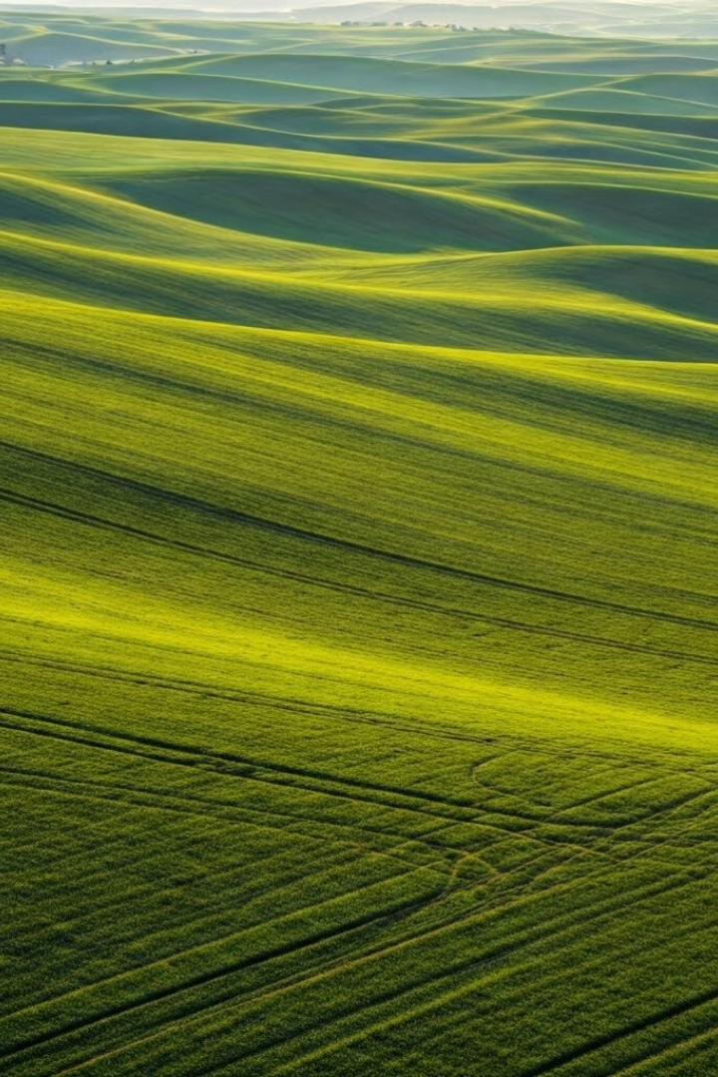
AgroEye: Revolutionizing Agricultural AI
AgroEye is an innovative web-app that allows farmers and other agricultural workers to get realtime insights about their fields using meteorological data.
by William Stella and Deniz Buldum

Slide 2
What Problem Does This Solve?
1
Suboptimal Resource Allocation
2
Inaccessible + Slow Results
Farmers struggle to effectively distribute water, fertilizers, and other resources.
Traditional methods of analyzing and displaying data around farmer's fields are either overly complex or unnecessarily slow.

Slide 3
Introducing AgroEye
Automated Analysis
Automated Data Visualisation
Chat Capabilities
AI-generated natural text analysis that takes into account the relevant information.
AI-generated graphs and plots of real environmental data that are easy to read, detailed, and generated fast.
If there are ever any problems with the analysis or you want to ask follow up questions, you can!

Slide 4
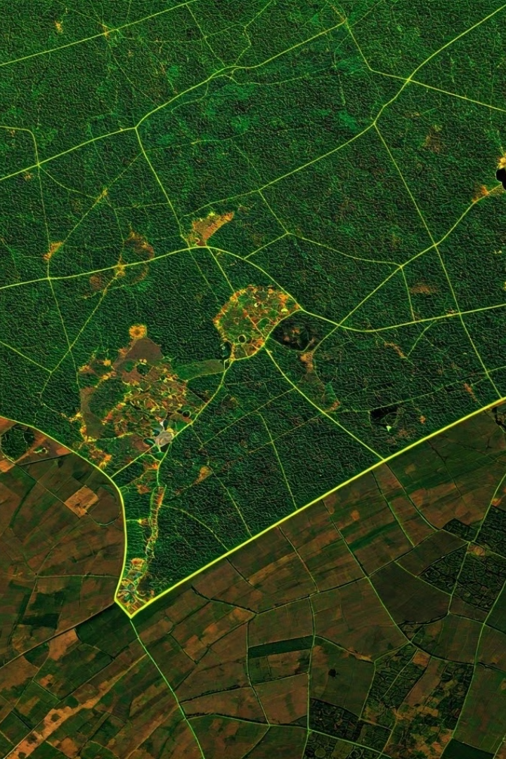
Our Data
Meteomatics API
Using the Meteomatics API we were able to get precise meteorological data based on the user's location.
10 Distinct Data Types
Including precipitation, temperature, wind speed, wind direction, and humidity.

Slide 5
Our AI Workflow
LLMs have a tendency to hallucinate, because of this it is sometimes hard to get consistent results. This is one of the issues we ran into in the start. Here is our custom workflow to fix that problem:
1
Preprocessing
To start, we get the raw data in CSV from our Express server (which uses the Meteomatics API). This data is uncleaned and contains abnormalities that make the LLM and the graphing library behave unpredictably. We clean the data before we send it so that the LLM has uniform data every time enabling it to make consistent responses.
2
Prompt Engineering
We have specifically engineered the prompt to be in a form the LLM is trained to understand. This entails making sure the data is clearly separated from other sections of the prompt, making sure that we have clearly stated the task, and making sure that the intended format of the response is clear.
3
Utility Functions
We have predefined functions in our code that the LLM is directed to reference. This reduces the hallucination rate of the LLM because all the LLM has to do is pick which graph type is the best for the data and plug the parameters into our predefined function.
4
Follow Up Responses
To further make sure the LLM answers all of the user’s concerns, we allow the user to follow up the AI's response with another question in case any part of the analysis didn't make sense.

Slide 6
Real Life Use Case
Mike - A Farmer From Nebraska
AgroEye Solution
As per Nebraska Public Media, Mike MacDonald is a farmer who harvests Corn, Beans, and Cereal crops. He said he "uses data to monitor moisture levels to help him make crop decisions and to inform how to structure his grazing cycle."
Right now Mike is using plain data to derive insights for his farm. What if Mike could use natural language to get better, more specific, and overall more personalized data about his farm in particular? That is AgroEye!

Slide 7
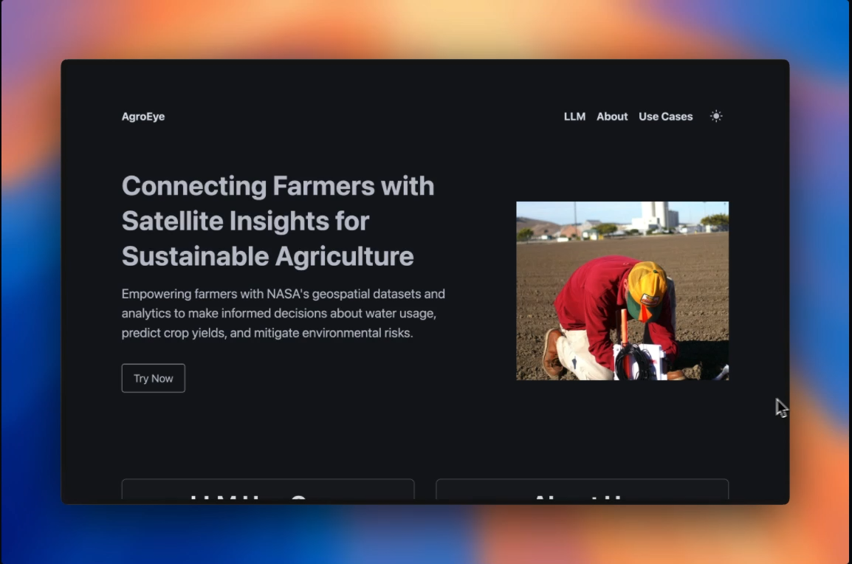
AgroEye Demo (nasa-hackathon-proj.vercel.app)

